Slide 1


Koo: Connect with Indians
in Indian Languages
India’s Aatma Nirbhar App

Slide 2
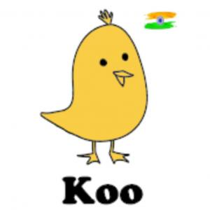
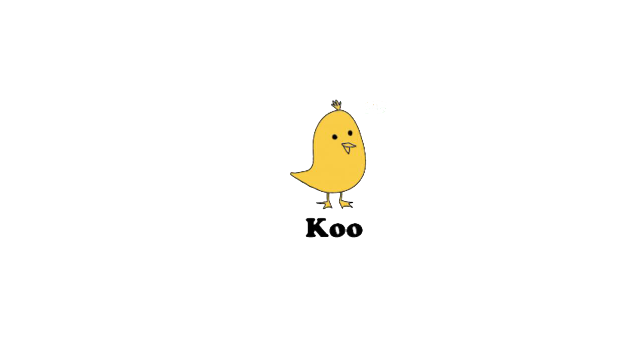







ABOUT
Koo is an Indian micro-blogging platform app built for Indians to share their views in their mother tongue and have meaningful discussions.
It empowers people to express their thoughts in Indian languages with a strong knit local Indian community.
Many prominent personalities like Sadhguru, Ravi Shankar Prasad, Anil Kumble, Javagal Srinath etc use Koo to express themselves everyday
Crossed 3M users
4.7 star rating in Google Play store (with 85k reviews)
Announced as Aatma Nirbhar App by Government of India
COMPETITORS
GOALS
Improve upon DAU/ MAU Ratio
App bounce rates
Session periods
Number of clicks in a session
Number of Koo’s created
Metrics to be focused
An indication for Engagement/stickiness to platform

Slide 3
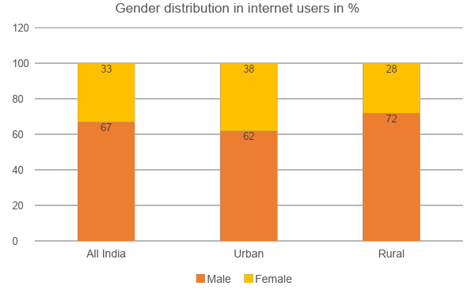
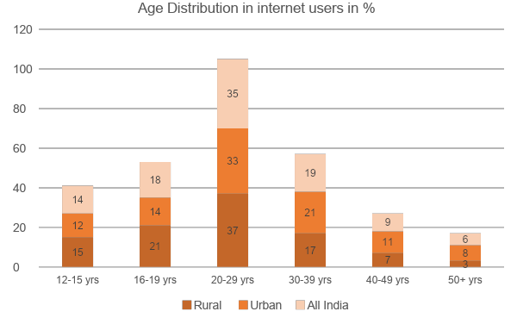
Social media usage in India based on demographics and age
Facts:
Focus:
290 million active social media users in India access social networks through their mobile devices
Two-thirds of Internet users in India are in the age group of 12-29 years.
Millennials and Gen Z are the main contributors for social media usage in India. 52.3 % of social media results come from millennials. 28.4 % of social media conversations are from Gen Z
67% of social media usage population are males in India, with the same ratio in urban and and rural areas
Top three age groups in internet users are in range of 16 and 39 years. They constitute 71% of whole population
Only one third of total internet users in India are females

Slide 4




USER PERSONAS
Ritviz Desai
34 | PM at Razorpay
Akshay Jain
20 | Student, IIT Bombay
Nilisha Mitra
24 | Chartered Accountant
Manikanta Dhanthala
19 | Owner of Photo studio
Uses social media during office hours to know trending news around him
And koos his opinion on that topic
Idolizes Kunal Shah, inspires from Virat Kohli, true fan of RCB cricket team.
Follows frequently kooing people and celebrities, checks koos of Kunal Shah, several successful entrepreneurs and RCB team koos
Uses koo app for entertainment, comments on celebs posts, creates memes and koos on trending hashtags, mostly koos on political issues
Halted his studies after class 12th and set up his very own photo studio
Passionate about movies, follower of several Tollywood and Kollywood heroes.
Uses koo app to know updates about upcoming movies in industry and also for general entertainment
But he believes he see a lot of memes, biased opinions and non relatable koos in between before knowing actual news
Has to navigate a lot to know what’s happening under multiple hashtags
Has to undertake multiple steps to mention his friend under a post.
Sees several bunch of koos in his feed whenever he opens the app and shut’s down instead
He gets different context koos under same hashtags and feels like koos were uncategorized

Slide 5
VALUE PROPOSITION CANVAS
PRODUCT
CUSTOMER
Benefits:
Empowers people to express their thoughts and have meaningful discussions in Indian languages
Engage social network with noteworthy links, photos and videos
Allows find interesting people or build a following of people who are interested in same thing
Experiences:
Kooing helps to get different opinions from different people all over the country
Elevates ongoing issues in the country
Engage with others creating meme materials
Helps to DM or connect with friends and like minded people
Fast news updates from official accounts
Updated new Experiences:
Enables sensible opinions from famous personalities over ongoing issue/s (under a trending hashtag)
Enhances user’s experience in home feed
Easy social networking with friends
Mitigating steps to navigate through trending hashtags
Wants :
I shall able to express my
opinion in my known language
Able to message friends personally or go viral with koos
Able to get updated news from news channels
Delay in
response of
CTAs
Multiple clicks to get the gist of the ongoing issue.
Lot much navigation in the app to go through all the hashtags
Able to market my Youtube channels, written blogs, my courses, etc.
Fears :
Engage with friends through koos
Features:
Engages users kooing with hashtags
Creates koos to share their opinions on contemporary issues
Aids in following cricketers, favourite stars, role models,etc.
Access to influential government bodies for fast updates
Instant messaging to to speak directly to influencers or friends alike
Needs :
Connecting with official
government bodies to express their opinions
Able to create koos by typing and
audio recognition
Ease in engaging with friends
Able to see official statements,
Press releases from official
accounts

Slide 6
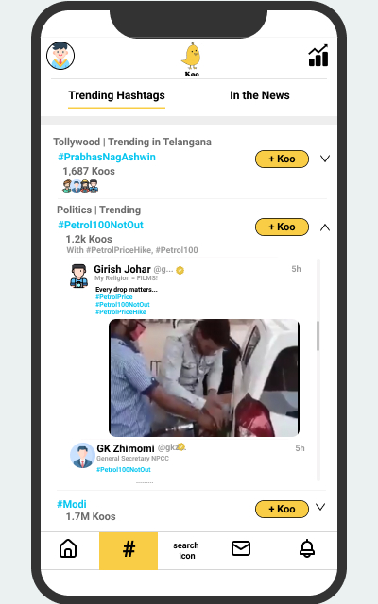
SOLUTION 1
Hashtag Information
Feature 1: Providing information related to trending hashtag with it helps user to know why it is trending, more specifically providing details-
Count of koos with hashtag
Hashtags which are kooed with the popular one’s
Categorization of hashtag with respect to issue or news like music, politics, movies, cricket, sports, football, etc.
List of some popular koos under same hashtag with navigation pane
User Value Proposition :
Addendum features help users to know more about the issue, looking at koos would help them to know depth of the issue, second or third ranked hashtags would help users know related news; scrolling bar under the hashtag would help to see more popular koos and their opinions, which ultimately makes navigation easier.
Success Metrics :
Number of clicks on CTA(Trending Hashtags)
Number of sessions (if session = 2 mins)
Session time period under CTA(Trending Hashtags)
Number of clicks on hashtag
Number of koos created from ‘Trending Hashtags’ page
1-day, 2-day, 4-day, 7-day users creating koos from ‘Trending Hashtags’ page

Slide 7
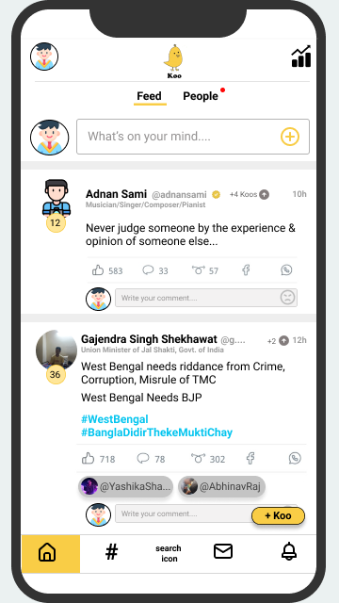

SOLUTION 2
Optimizing Home Feed
Feature 2 : Showing count of new koos( +4 Koos ) created by the person you’re
following after user’s previous session. This number is shown in every koo in the home feed.
User Value Proposition: This would make user to engage more in the feed by looking at the count. Instead of showing them bunch of koos at a time, showing them count of koos of each person would make user to scroll through the home feed page
Success Metrics:
Bounce rates
Number of sessions
Session period under ‘Feed’ page
Number of reactions, re-koos, comments in ‘Feed’ page in the first and second session
Feature 2 : Recommending friends or mutual followers to the person in a koo
Recommendation to be based on
Frequent mentions of ‘B’ by ‘C’ in koos
Ensuring difference in followers of B and C is less than 5K
‘B’ and ‘C’ should be mutual follower of ‘A’
A
User Value Proposition:
This would increase social networking with friends, creates engagement with like minded people, and mitigates friction in kooing and commenting
Success Metrics:
Number of mentions of B’s in koos
Ratio of number of ‘B’ mentions and total B’s recommended
1-day, 2-day or 4-day gap mentions
in a koo
B
C

Slide 8
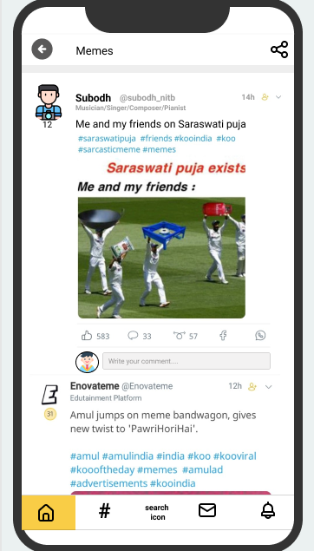
SOLUTION 3
‘Memes’ page
Feature 4 : Creating a CTA button ‘Memes’ in the home page, where users able to
enjoy memes under same feed.
Koo would be considered in this page
when user mentions hashtag consisting of keyword ‘meme’; Example: #memes,#funnymemes, #memeworld, #memekajalwa
Created in last 48 hrs
Prioritised based on the trending hashtags mentioned with the koo
User Value Proposition :
This page makes user enjoy latest memes, get exposure to more meme material and brings back user’s to this page in short intervals.
This makes users to understand contemporary issues or news in different way
Success Metrics:
Number of clicks on ‘Memes’ CTA button
Bounce rates of ‘Memes’ page
Number of sessions
Session time period in ‘Memes’ page
Number of reactions, re-koos, comments, facebook and whatsapp shares
1-day, 2-day gap ‘Memes’ page users

Slide 9

BLOG POST
By Alsatwar Sravan Kumar published 21st Feb, 2021
Android | Social- Media | Business
Koo bird chirps with extra new features
in its app
Koo, The microblogging site was co-founded by entrepreneurs Aprameya Radhakrishna and Mayank Bidwatka. While the app was launched in early 2020, its participation and the subsequent winning of the government’s Aatmanirbhar App Innovation Challenge brought it under the limelight. Now Koo has come up with extra new features to engage more number of users in their app.
Koo has incorporated ‘meme’ CTA in its app, where meme material is shared and encourages other user’s to create more memes. In addition, they have also made changes in presenting trending hashtags in app which ease user to navigate in the app. Moreover, Koo app makes a complete social networking site, enjoying connecting with others. Koo CEO, Aprameya believes that added features would help in retaining their customers on the daily basis. Now, Koo app has released its updated version and its all set to gain more number of users and make our India as ‘AatmaNirbhar’.

Slide 10
Thank you!
VAISHALI KURIL
Final year student, IIT(ISM) Dhanbad
vaishalikuril24@gmail.com

